Slide 1


INSPIRE action on Alternative Encodings
Brief introduction
Joint Research Centre
The European Commission’s science and knowledge service

Slide 2
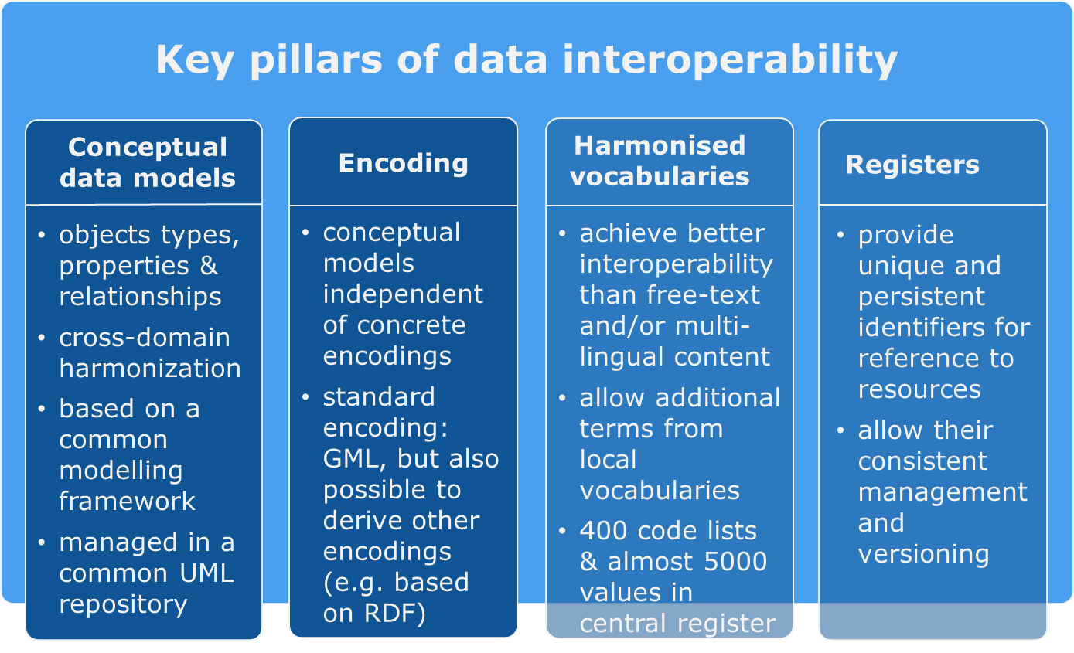
Context
The consumption of INSPIRE data is not easy
TG define complex data structures
Existing applications (libraries, web, desktop, mobile) have difficulties to consume the content
Rapid evolution of mainstream ICT
On-going action under the INSPIRE maintenance and implementation work programme to define alternative encodings

Slide 3
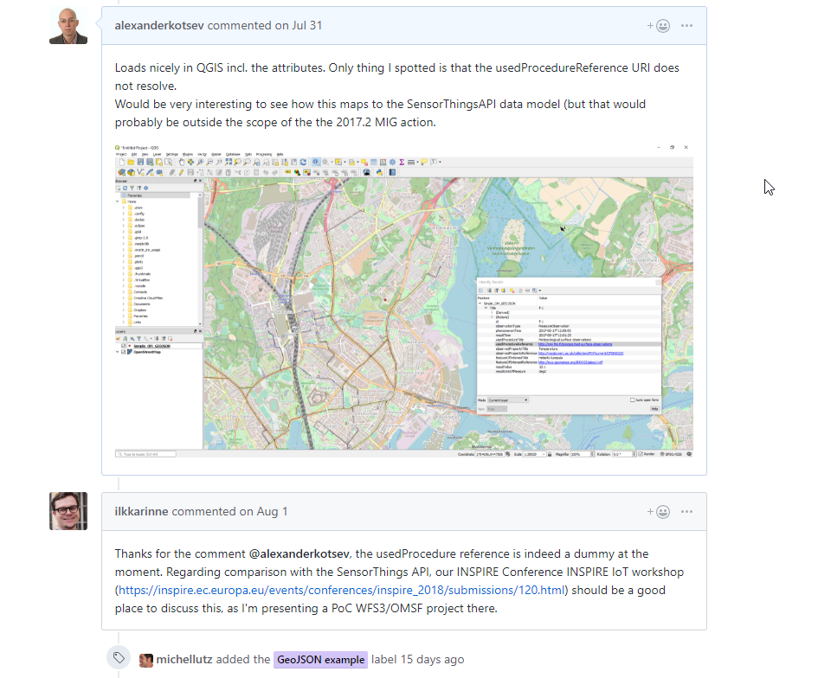
2017.2: Alternative (to GML) encodings
Tasks
Encoding rule for GeoJSON (as a first example) → Good Practice document 1
Generic rules / approaches for simplifying INSPIRE data models (useful for a number of alternative encodings) → Good Practice document 2
Specific GeoJSON encodings (combining (1) and (2)) for Addresses, Environmental Monitoring Facilities & observations (as initial examples)
Github working space: https://github.com/INSPIRE-MIF/2017.2
Other alternative encodings (e.g. GeoJSON for other themes, RDF, Geopackage, …) can be proposed in the future following the INSPIRE Good Practice procedure

Slide 4
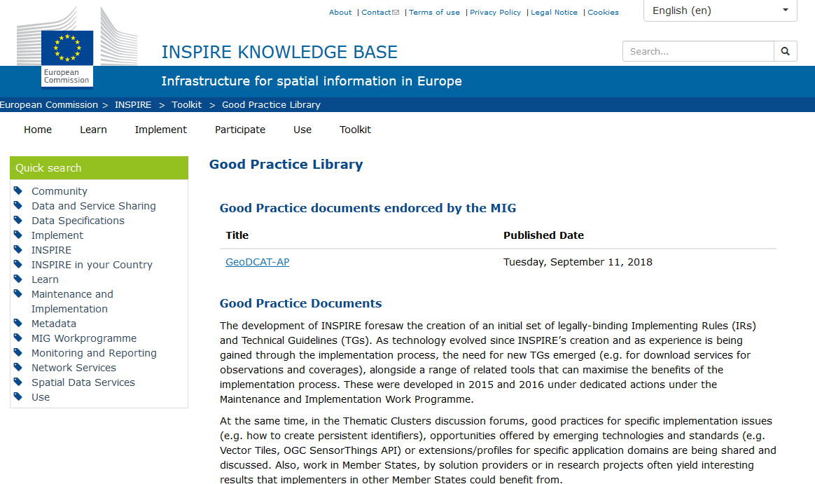
INSPIRE Good practices - procedure
Step 1. Initiation using a "good practice fiche“
evidence that the solution has been put into practice, and
has received broader support
Step 2. Outreach through a webinar
Step 3. Submission for inclusion in a good practices section in the INSPIRE Knowledge Base
ideally with support from one or several INSPIRE MS representatives
Step 4. Opinion of the MIG to endorse, ask for clarification or reject the good practice
Step 5. Feedback from users through the good practice repository
https://inspire.ec.europa.eu/portfolio/good-practice-library

Slide 5
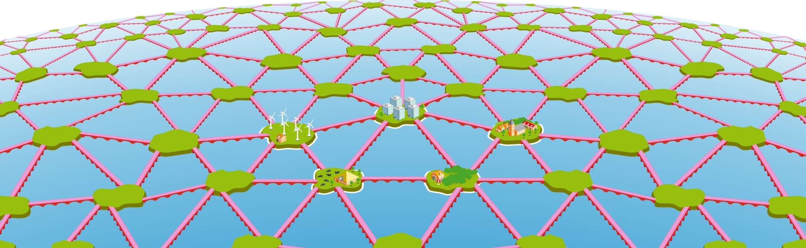
UML– Linked Data Dutch best practice for transforming UML Application Schema to Linked Data Ontologies
The approach centred around developing transformation rules for mapping from the source UML geo metamodel to the target metamodel(s) for SKOS/RDF/SHACL/OWL implementations. The rules were developed on the basis of the existing metamodels but also on a use case about a test case domain model: the Golf Course Domain Model and a related dataset
Paul Janssen
p.janssen@geonovum.nl
SDI.next - PLDN – Amersfoort

Slide 6
Content
UML legacy
Linked data revelation
UML – LD combination
UML – LD derivation

Slide 7
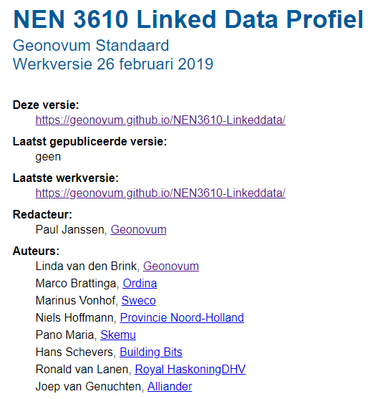
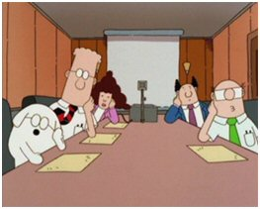
The Team

Slide 8


Principal goal
Universe of Discourse
(UoD)
model of
model of
UML
model
RDF
model
transformation

Slide 9
UML legacy
NEN 3610, the GeoBaseModel. The information standard for the exchange of geo-information. It prescribes UML as the formal language to specify semantics and advocates GML as technical implementation format. NEN 3610 is therefore not equiped to realize data – and semantics sharing through linked data.
ISO
ISO
ISO TC/211
INSPIRE
European practice
NEN3610
Dutch GeoBaseModel
National standards
Data exchange
IMTOP
Domain standards
IM . . .
IMMetingen
IMAER
IMWA
IMNAB
IMKAD
IMKICH
IMWE
IMGeo
IM0101
IMRO
IMLG
IMOOV
IMBRO
IMKL

Slide 10
UML-OO GeoBaseModel (NEN 3610)
Linked data
Pyramid of specialzation
Silos extending common rules
Stack of profiles and extensions
Pyramid of reuse and reference
reuse and references of ontologies
Rules and semantics
international
ISO
Generic
ontologies
time, geometry, location
Rules and semantics
national
Generic functional
ontologies
Functional layer
temporal, identification
Domain models
All concepts
Centralized vocabulary
tree, road, buliding etc
Domain specifications
domain-ontologie
Subset and
reuse of concepts
Use case defines universe of discourse
Domain defines vocabulary – domain standard
The Universe is the Universe of discourse
Anybody can say anything about anything

Slide 11
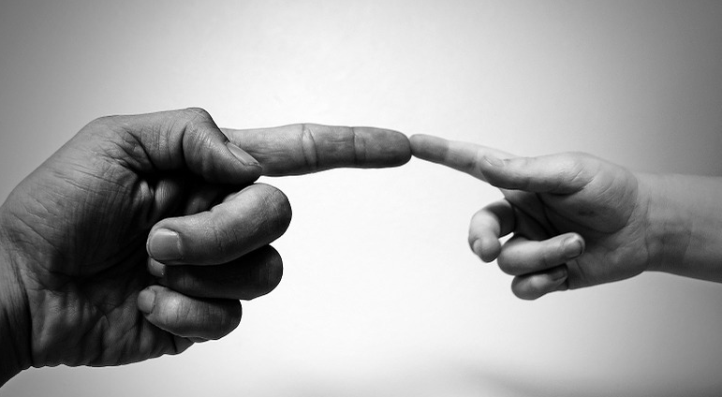

Linked data revelation
Opening up the data Silos
Centralized vocabulary
Domain specifications

Slide 12
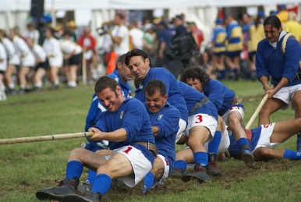


- NOT IN COMPETITION - Fundamental differences relate to different use cases UML and LD are complementary
UML model use case: data exchange, harmonized, controlled (environment), handled by applications, (data quality centred). No surprises!
LD use case: data publication, open environment, ‘handled by the web’ (data access centred). Be surprised!?

Slide 13
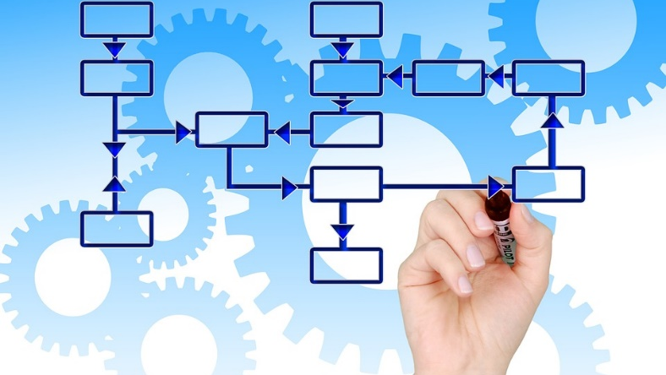
Typical UML domainmodel use cases/concepts
vocabularies of classes – taxonomy
Codelists
datastructure/application oriented
4 data publishing – exchange - application oriented
5 data validation
6 vocabularies related, harmonisation

Slide 14
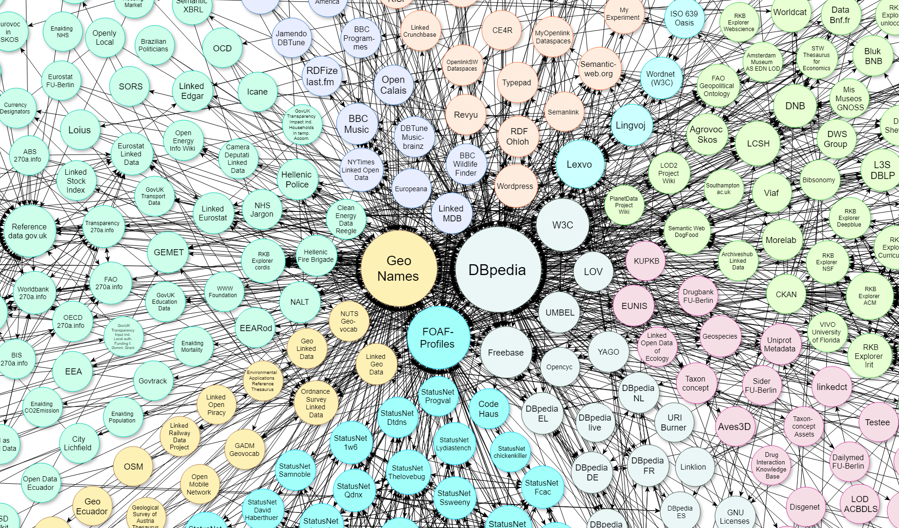
Typical LD model use cases/concepts
vocabulary, thesaurus
2a Knowledge model (ontology) simple
2b Knowledge model (ontology) complex
3 web of data (publishing, sharing), semantic web
4 Knowledge deduction, reasoning
5 artificial intelligence

Slide 15

UML – LD combination UML – LD derivation
Let’s make UML and LD interoperable

Slide 16
Universe of Discourse
(UoD)
model of
model of
UML
model
RDF
model
transformation
Building on existing knowledge:
ISO 19150-2: 2015 - Geographic information -- Ontology -- Part 2: Rules for developing ontologies in the Web Ontology Language (OWL)
INSPIRE - Guidelines for the RDF encoding of spatial data (ARE3NA)

Slide 17

Universe of Discourse
(UoD)
model of
model of
UML
model
RDF
model
#1
RDF
model
#2
autom.transformation
manual refinement
conforms to
conforms to
conforms to
Use standardized vocabularies
Complex datatypes as concepts
Codelist values as concepts
Relating external concepts
Multiple inheritance
UML:Class not same as OWL:Class
UML NEN3610
metamodel
RDF
GeoBase
metamodel
Notes:
UML:Class not the same as OWL: Class.
Often UML :classes are used for data structuring. The OWL :Class is exclusive for semantic structuring. Basis for reasoning

Slide 18

Universe of Discourse
(UoD)
model of
model of
UML
model
RDF
model
#1
RDF
model
#2
autom. transformation
manual refinement
conforms to
conforms to
derived from
RDF
GeoBase
metamodel
XSD
data
structuur
conforms to
Input
Input
conforms to
XML
data
Automated conversion
RDF
data
input
output

Slide 19
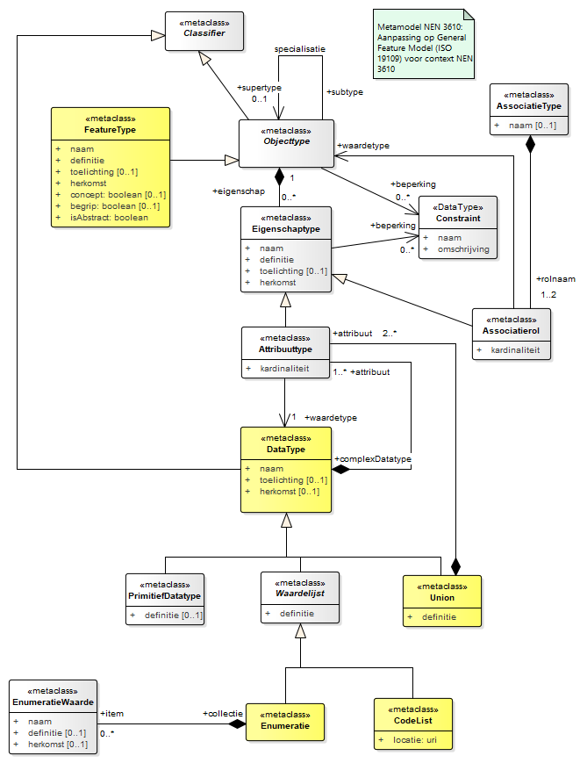
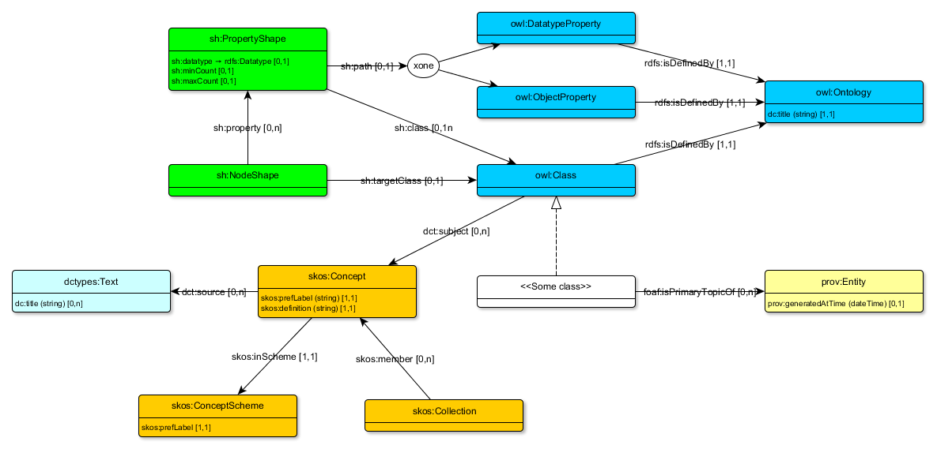
Metamodels compared and mapped UML profile – RDF/SKOS/OWL/SHACL
SHACL
OWL
SKOS

Slide 20
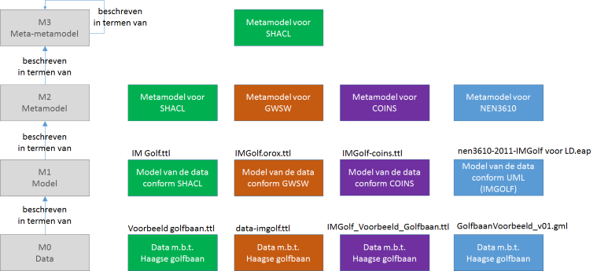
Relating three Metamodels
DSO/SHACL
OMG – 4 layer metamodel
OroX
COINS
M3
M2
M1
M0

Slide 21
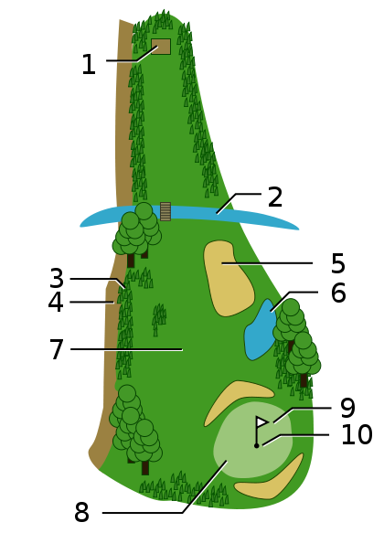
Testing on the golfcourse
http://commons.wikimedia.org/wiki/File:Golf_field.svg
1 teeing ground
2 water hazard
3 Rough
4 out of bounds
5 sand bunker
6 water hazard
7 fairway
8 green
9 Flagstick
10 hole
Koninklijke Haagse Golf en Country Club

Slide 22
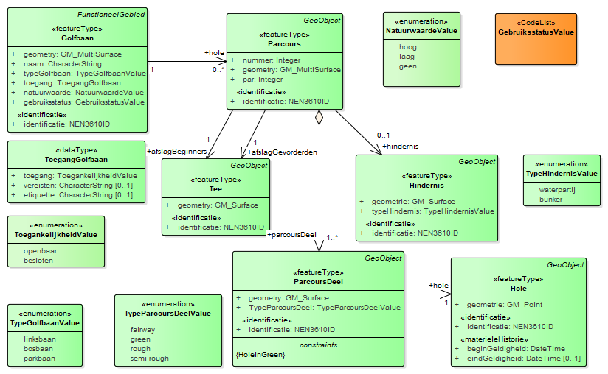

Slide 23
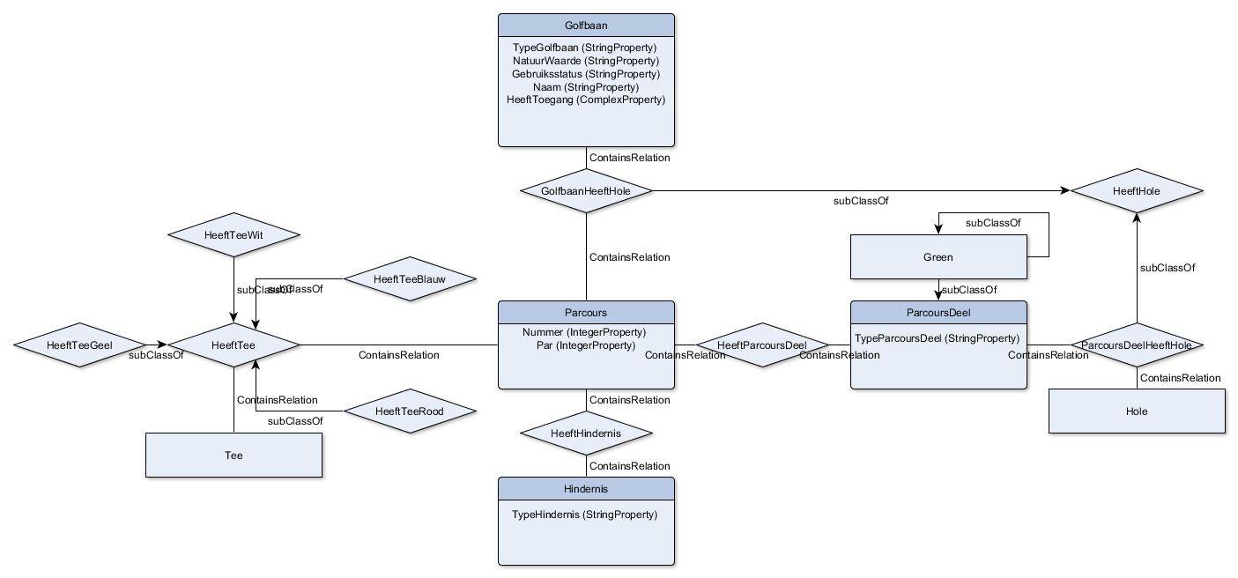
COINS - ontology

Slide 24
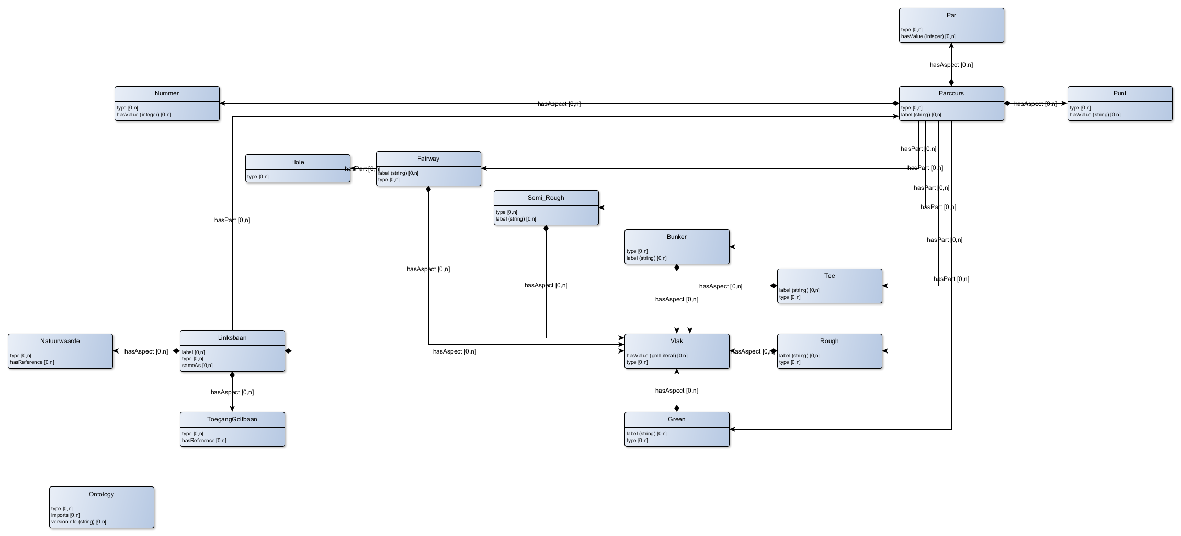
OroX - ontology

Slide 25
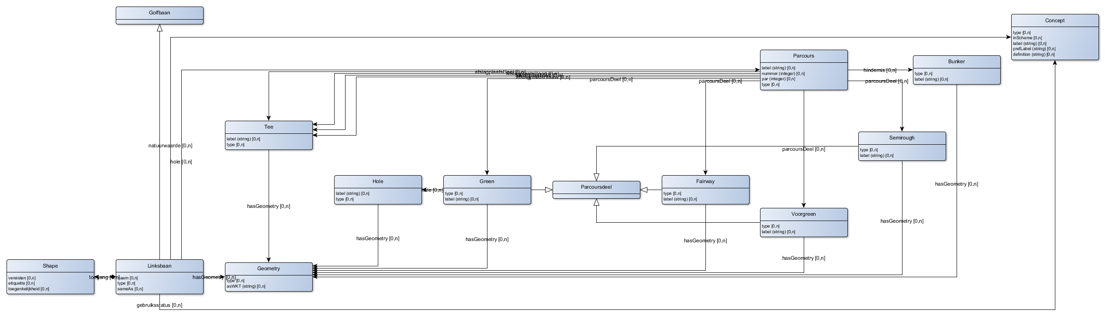

DSO/SHACL ontology

Slide 26


Universe of Discourse
(UoD)
Still work in progress
model of
model of
UML
model
RDF
model
#1
RDF
model
#2
autom. transformation
manual refinement
conforms to
conforms to
derived from
RDF
GeoBase
metamodel
XSD
data
structuur
conforms to
conforms to
Input
Input
XML
data
Automated conversion
RDF
data
input
output

Slide 27
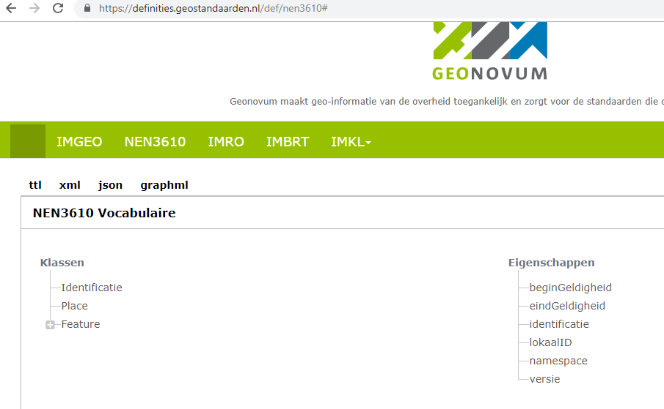
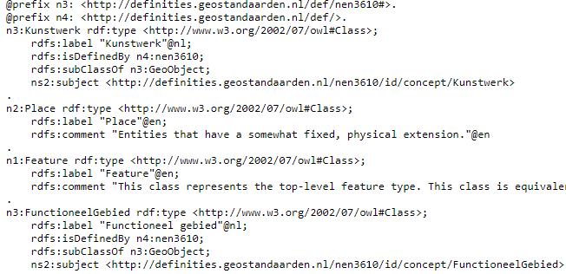
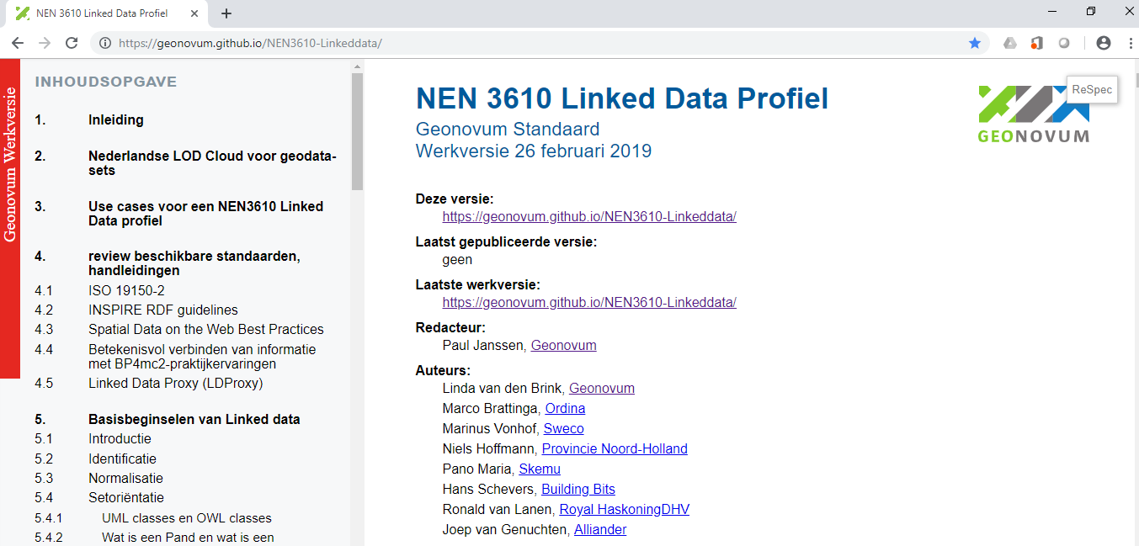
NEN 3610 Ontology is published
https://definities.geostandaarden.nl/def/nen3610
#
https://geonovum.github.io/NEN3610-Linkeddata/

Slide 28
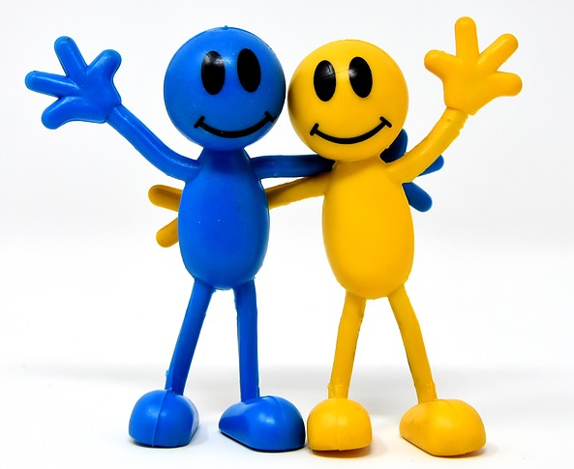

Conclusions
UML-community and Linked data community are sharing views
UML -> LD conversions are being developed and understood
NEN3610 Ontology is published
UML and LD are becoming interoperable

Slide 29
